Slide 1
Re-imagining Kennecott: Remediation and Maintenance
Douglas Bacon
State Of Utah Dept. Of Environmental Quality
Project Manager - Kennecott
ITRC – State Engagement Coordinator & Utah’s Point of Contact

Slide 2
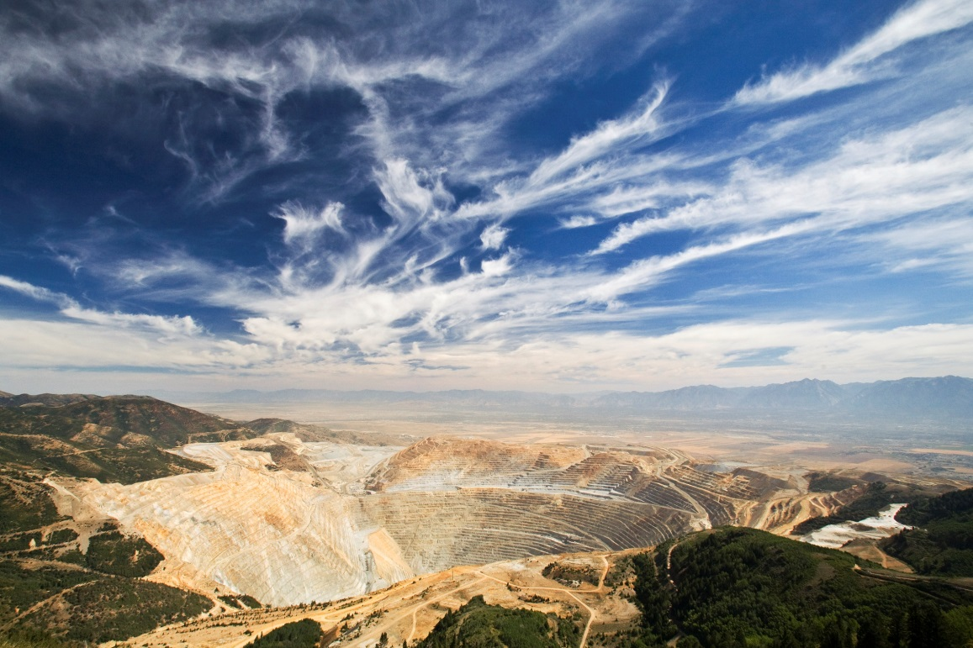
Kennecott Response Action – Overview
General South Zone Actions:
  Excavation and removal of contaminated soil and solid mine waste from residential, commercial and other sensitive locations.
  Extraction, treatment, management of impacted groundwater.
General North Zone cleanup:
  Excavation and removal of contaminated soil and solid mine waste from accessible locations and during facility replacement or demolition.
  Excavation and removal of contaminate soils and solid mine waste from ecologically sensitive areas.
  Monitor natural attenuation and surface capture of groundwater.
  Wetlands monitoring including biological, water and sediment sampling.
Ongoing re-assessment of remedy performance
Bingham Canyon Mine (Source: Rio Tinto Kennecott)
Notes:
As noted by Kerri, EPA, the Utah Department of Environmental Quality (UDEQ) and Rio Tinto Kennecott Copper (Kennecott) have worked together to design and implement cleanup actions in the Kennecott North Zone and Kennecott South Zone.
Under the 1995 MOU, the three parties collectively manage the Kennecott site as a Superfund Alternative site utilizing the best means possible to ensure cleanups were/are pursued expeditiously and in a manner protective over time.
Since both Zones are geographically large and their issues complex, I will give an overview of the remediation at both. I will follow this up with a more detailed look at individual areas, highlighting cleanup that prepared lands in Daybreak for reuse.
All cleanup actions to date and currently underway were and are being implemented in accordance with administrative orders, records of decisions and consent decrees agreed to by EPA, UDEQ and Kennecott.

Slide 3
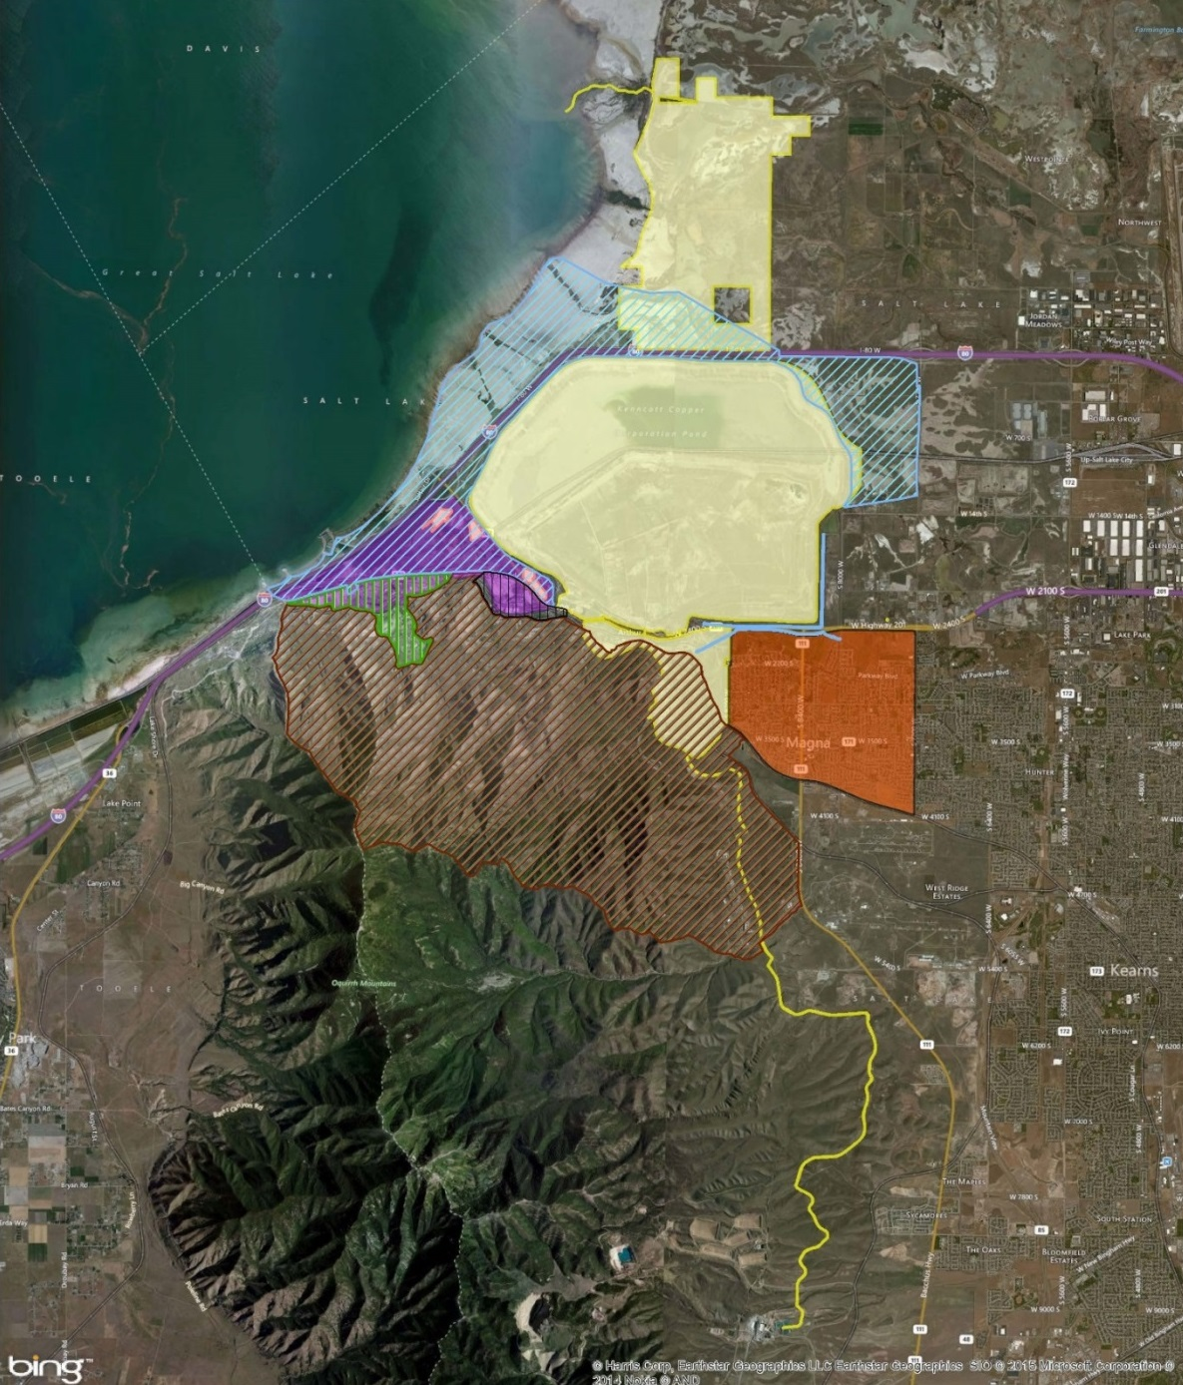
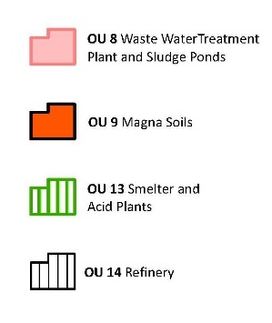
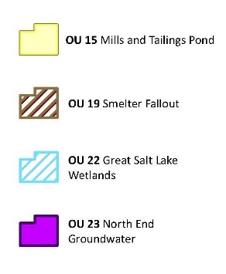
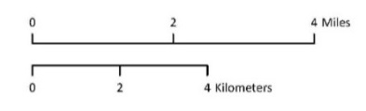
Kennecott North Zone
Notes:
Note: Again, this is the same map that Kerri Fiedler provided.
This is a map of the 8 OUs in the North Zone, see the key on the right with each OU in a different color.
There have been 25 operable units designated, across both Zones (one was withdrawn).
Portions of OU25 are distributed throughout the extent of the North Zone.

Slide 4
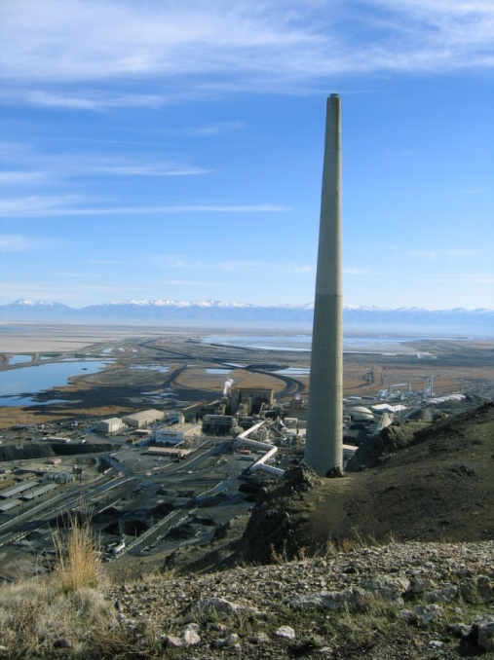
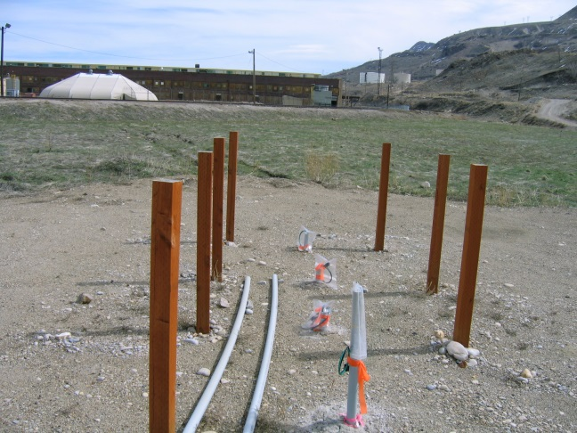
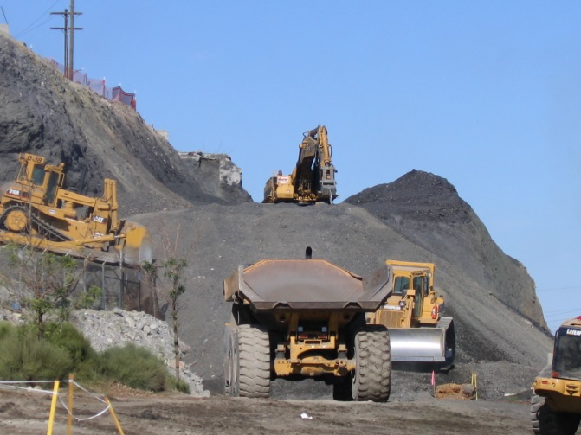
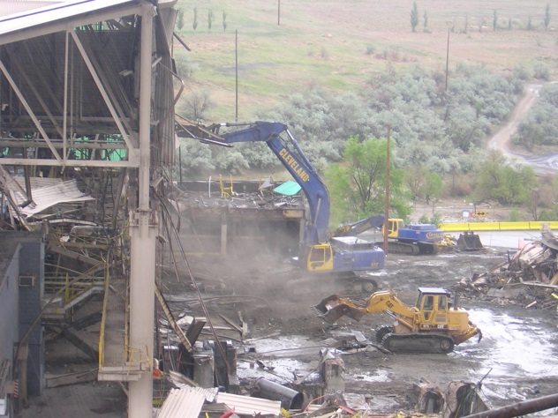
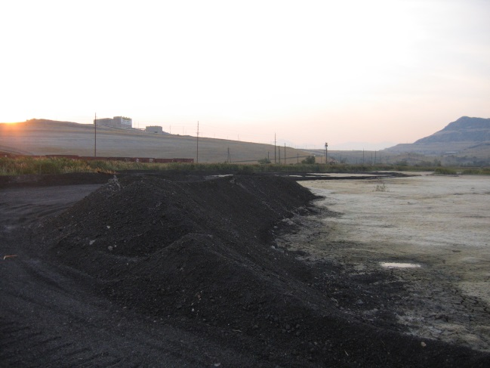
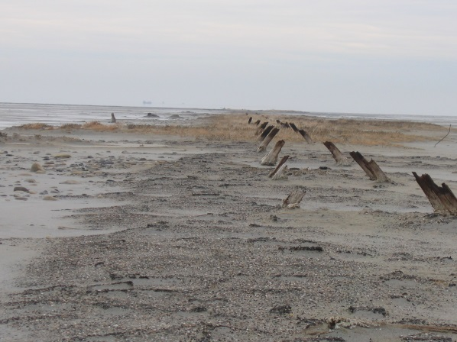
North Zone Remediation
Consolidate, Cap, and Monitor
(Source: UDEQ)
Excavation & Removal
(Source: UDEQ)
Operational Compliance with State Permits
(Source: UDEQ)
Demolition and Soil Management
(Source: UDEQ)
Source Control - Habitat Management
(Source: UDEQ)
Source Assessment
(Source: UDEQ)
Notes:
The main contaminants of concern in the North Zone are arsenic, cadmium, lead, and selenium.
Cleanup of the Kennecott North Zone has and continues to include:
The excavation and removal of solid mine waste (sludges, slimes, slag, tailings) and contaminated soils to an on site CERCLA repository
The consolidation of solid mine waste and contaminated soils, and the application of soil covers or engineered caps
The monitoring of groundwater and collection when such daylights above applicable surface water protection standards or site specific protection standards
Source assessment, control and monitoring
Operational compliance with State of Utah protection permits
A particular source of concern is a series of non-contiguous groundwater plumes containing arsenic and selenium in concentrations above surface water protection standards for waterfowl.
The impacted groundwater underlying the Refinery and Smelter enters nearby wetlands through springs and seeps.
Native birds in the wetlands are knowingly sensitive to selenium, and potentially affected by elevated arsenic concentrations.
Kennecott, UDEQ and EPA are currently re-evaluating previously selected remedies and protection metrics for the North End Groundwater Plumes and the Garfield Wetlands, to better affect protection of the waterfowl using the habitat.
These cleanup actions have benefitted over time from community participation via reviews by members of the North End Technical Review Committee, regular briefings to the Magna Area Community Council and the aid of community leaders when characterization efforts were initiated.

Slide 5
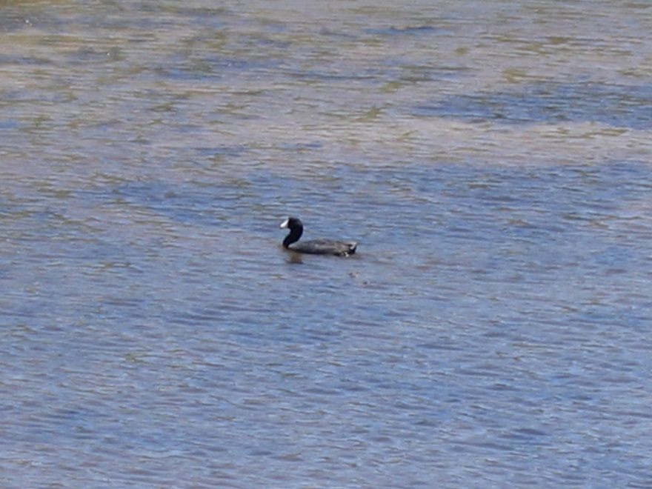
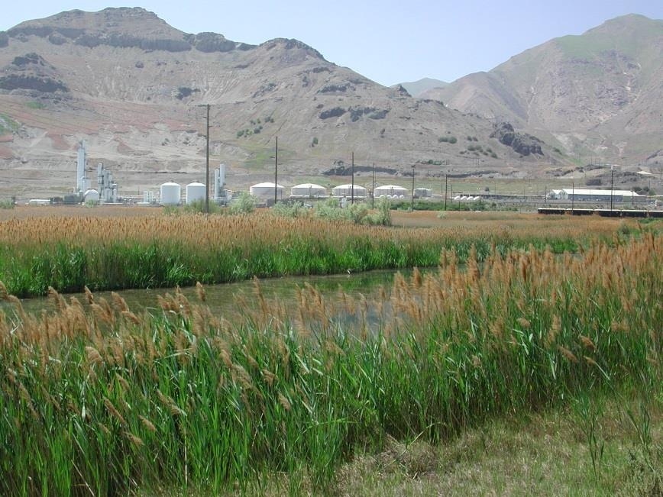
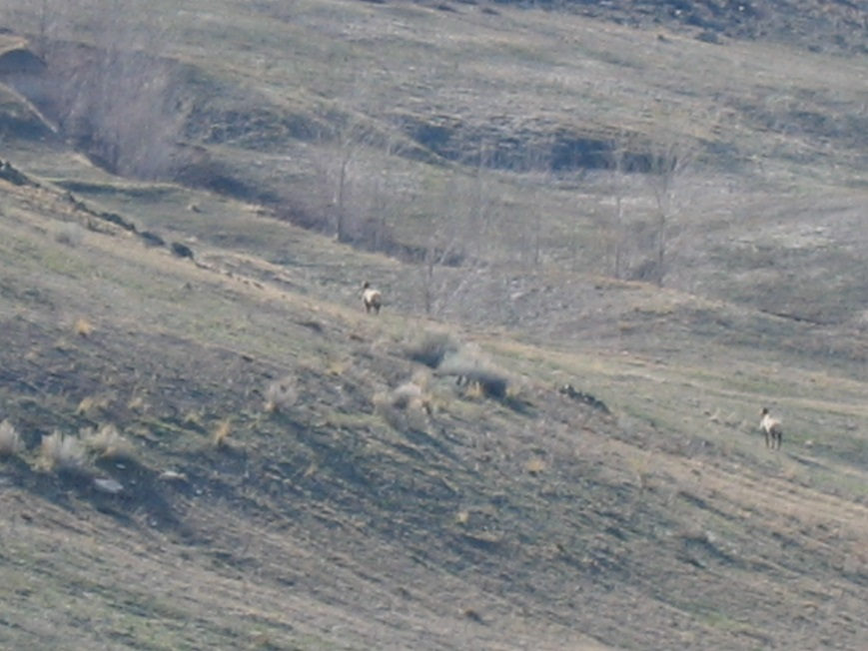
North Zone Remediation Success
Preservation of Habitat
(Source: UDEQ)
Revitalization of wetlands in the North Zone
(Source: Rio Tinto Kennecott)
Revitalization of Range Habitat
(Source: UDEQ)
Notes:
Remedial efforts were/are intended to be protective of current or intended land uses. This included ensuring protection to the site workers involved in the active processing operations and other industrial activity.
Soil management primarily focus on protection of the site workers when areas are disturbed and assurance that excavated soil is disposed of properly.
In sensitive environments, past mineral processing and waste management activities were/are addressed to preserve these areas, re-establish habitats, and/or remove habitat due to constraints on source control or habitat value.

Slide 6
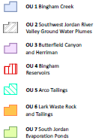
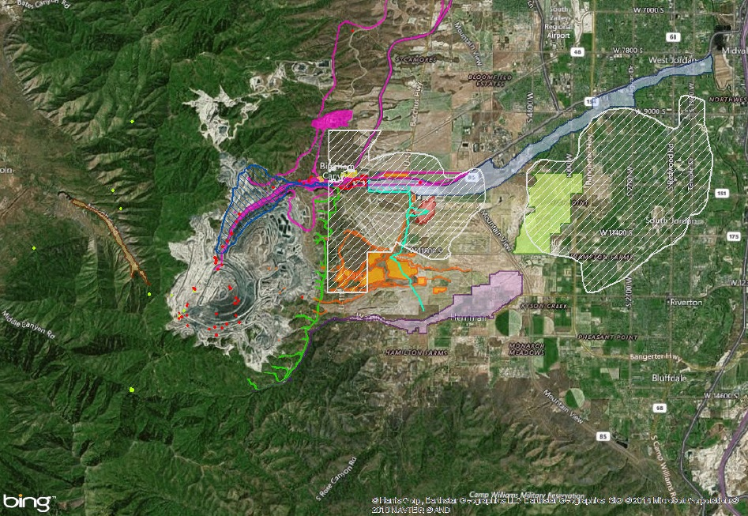
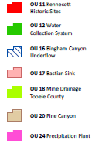

Kennecott South Zone Overview
Notes:
Note: This is the same map that Kerri Fiedler provided in her presentation.
This is a map of the 15 OUs in the South Zone, see the key on the right with each OU in a different color.
In addition portions of OU25 are located around the Kennecott South Zone.
To give you an idea of the scale of the South Zone, the scale bar at the bottom left of the map shows the distance of 5 miles. The Bingham Canyon Mine (open pit) measures approximately 2.5 miles across and is approximately ¾ of mile deep. Approximately 11 Statues of Liberty, stacked end on end, could stand as a column in the Bingham Canyon Pit.
When mining activities began back in the mid 1800s, there was very little residential development near the South Zone. Over the course of the 1900s development on the outskirts of the mining held property began first with agricultural use and now includes residential and commercial land uses.
In the late 1980s - early 1990s UDEQ conducted preliminary assessments in both Zones. These initial inquires discovered both solid mine waste and contaminated soils in areas being developed within the surrounding communities. The evaluations also discovered the degradation and contamination of the principal aquifer in the southwest Salt Lake Valley from mining influenced water management practices.

Slide 7

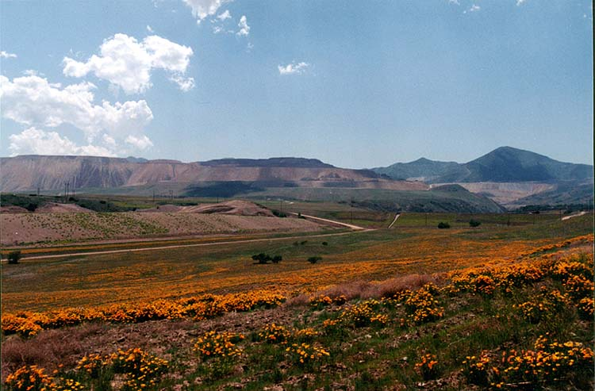
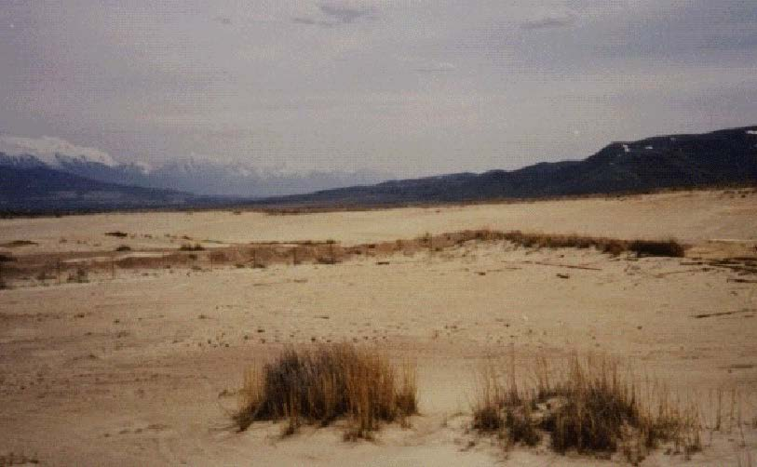
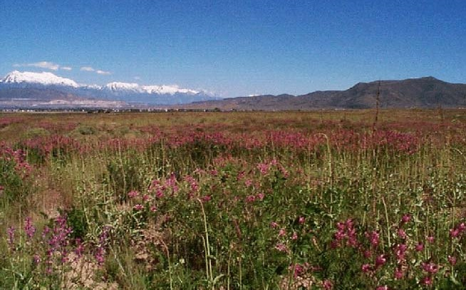
South Zone Remediation – General Solids Strategies
Excavation and Removal
Capping
Re-grading / Land Contouring
Institutional Controls
Bingham Creek Removal Action, 1995-1997 (Source: RTKC)
Lark Tailings Reclamation Action, 1995 – 1997 (Source: RTKC)
Notes:
Solid mine waste and soils have and are found to contain elevated concentrations of arsenic, cadmium, lead, and selenium as a result of past practices of managing solid mine waste and mining impacted water.
Before the threat of these contaminants was recognized, homes were built on former flood plains along the drainages leading away from the Bingham Mining District. The residential development activity increased the emphasis to cleanup these areas where solid mine waste was deposited.
Cleanup of the Kennecott South Zone site has and does include:
Excavation and removal of solid mine waste and contaminated soil from residential and ecological sensitive areas,
Removal and capping of waste rock and tailings,
Re-grading of soil in degraded areas during reclamation activities,
Implementation of institutional controls

Slide 8
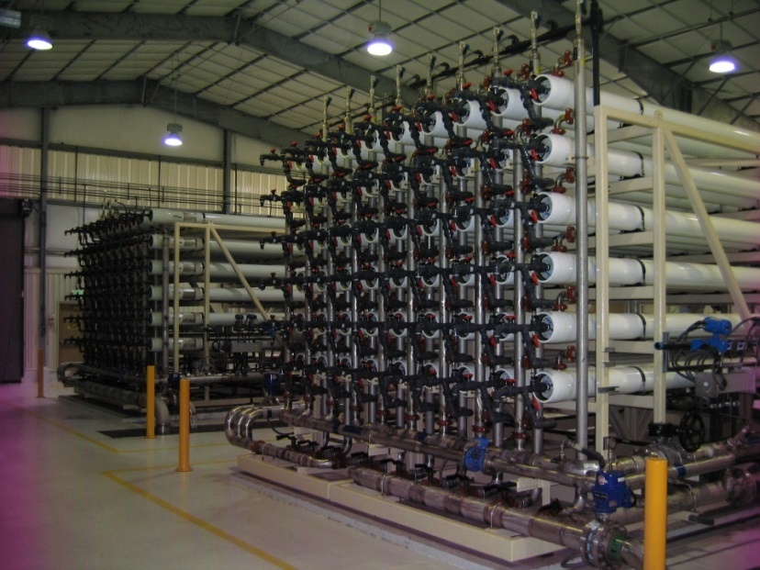
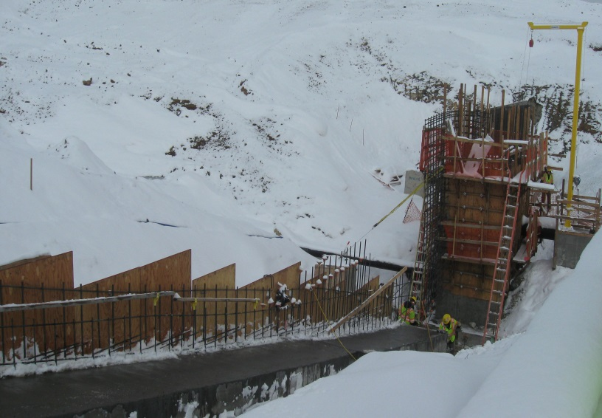
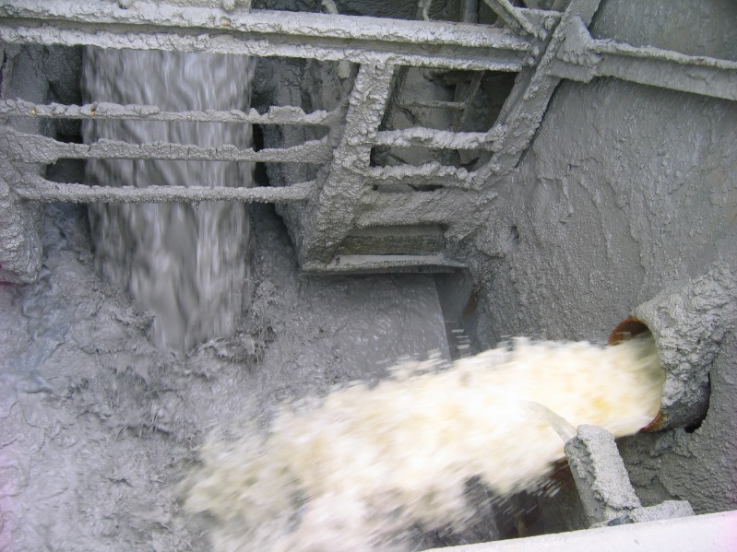
South Zone Remediation – General Groundwater Strategies
Reverse Osmosis Treatment System
(Source: UDEQ)
Source Control Measures – Collection System Cut-off walls
(Source: UDEQ)
Management of Extracted Core Waters
(Source: UDEQ)
Notes:
By the mid 1980s UDEQ had initiated a damage claim for impacts to the primary aquifer in the southwest quadrant of Salt Lake Valley. Years of mining influenced water (dating back to early 1900s) led to the introduction of both acidic mine drainage as well as circum-neutral drainage which contained elevated concentrations of aluminum, arsenic, cadmium, copper, iron, lead, manganese, sulfate and total dissolved solids. By 1992 UDEQ and EPA initiated a joint assessment to address the two plumes of mining influenced water.
Impacting the principle aquifer, the two plumes underlie approximately 72 square miles. The two plumes, not contiguous, contain different qualities due to the types of mining influenced water impacts.
Collectively both plumes have sulfate and total dissolved solids concentrations that exceed the State Primary Drinking Water Standards.
The Zone A plume contains a core of water with low pH (3), metals above State Primary Drinking Water Standards, highly elevated Sulfate (>20,000 mg/L) and Total Dissolved Solids (>40,000 mg/L) concentrations above the State’s Primary Drinking Water Standards.
Two principle long-term remedial action objectives (of the response actions being pursued under CERCLA and the State’s NRD Project) are to (1) contain the spread of groundwater contamination and (2) reduce the groundwater contamination present.
Under CERCLA, Kennecott is:
Extracting/neutralizing/disposing of the core water in the Zone A plume utilizing the existing mining infrastructure (including their tailings pipeline, the neutralization characteristics of the tailings and permanent sequestration in their tailings impoundment).
Maintaining source control measures and compliance with State of Utah’s groundwater protection program permit restrictions.
Under the State of Utah’s Natural Resource Damage settlement:
Kennecott and Jordan Valley Water Conservancy District are extracting circum-neutral groundwater with elevated Sulfate and Total Dissolve Solids, using pretreatment filtration – chemical stabilization – reverse osmosis – post chemical addition, and producing municipal quality water for use by the four communities (West Jordan, South Jordan, Riverton and Herriman) overlying the two plumes.
The projects by Kennecott and Jordan Valley are implemented under a 2004 Three Party Agreement with the State (pursuant to a 1995 NRD Consent Decree) which in part requires the parties to “restore” and “acquire” the equivalent volume of the overall damaged resource (8235 acre-feet of water).
Under purchasing contracts the Cities of West Jordan, South Jordan, Riverton and Herriman benefit from deliveries of municipal quality water with some of the provided water at a reduce rate. A portion of the water delivered to South Jordan City is brought into the Daybreak Community as part of the City’s provision infrastructure.

Slide 9




Daybreak – Master Planned Community
Daybreak
Notes:
By the mid 1990s, it was clear that sustainable housing and commercial growth was expected in the Salt Lake Valley in the coming years.
In response to this potential for growth, in 2001 Rio Tinto established the Kennecott Land Company (Kennecott Land) to develop non-mining land or reclaimed lands and to ensure soils complied with applicable land use action levels.
Rio Tinto owns nearly 93,000 acres of land in the Salt Lake and Toole Counties, so they have great interest in cleaning up contaminated land and protecting uncontaminated land for redevelopment.
As noted In 1993, Kennecott began cleaning up mining legacies including:
Solid mine waste deposited in creeks, canals and ditches
Removal of lime-treatment sludge and tailings in surface impoundments,
Redesign of water management facilities to prevent infiltration and migration off-site
Removal of solid mine waste used to create berms, dikes and other surface structures
Lands were cleaned up to action levels based on the then land use.
In 2001 under a Record of Decision for Operable Units 7 and 17 (including others), EPA and Kennecott agreed to place an operation and maintenance plan over OU7 and OU17 (completed in 2004) to address further soil management actions in case of redevelopment.
This was required because waste was left in place above the site wide unrestricted land use action levels for arsenic (50 mg/kg) and lead (500 mg/kg).
Under the revised 2006 O&M plan two soil management work plans were drafted by Kennecott and Kennecott Land to cover soil management work in OU7 and OU17, and they are currently used to guide further soil management efforts elsewhere in Daybreak.
In 2013 Salt Lake County created a contaminated soils ordinance which in part covers the Daybreak area,
The County ordinance (a jurisdictional institutional control) is in place because soils can exceed the site specific residential land use action levels (established in 2006) and the site wide unrestricted land use action levels (established in 2001).
Salt Lake County currently is working with UDEQ to develop and implement the ordinance through soil management plans drafted by UDEQ and EPA.
In 2015/16 Kennecott entered into five Environmental Covenants (Bingham Creek and Channel, Commerce Park - Tailwater Ditch, Historic Railroads – Lark Spur, Bastian Sink, and Historic Landfill) which require further response action by proponents of future land use changes.
The Environmental Covenants (ECs) are a proprietary institutional control to ensure areas which exceed the site wide unrestricted land use action levels and/or the residential land use action levels are addressed when land use is proposed to be changed.
The ECs grant onto Kennecott and the agencies the ability to enforce the soil management procedures specified in each.
On top of the soil management steps that have been in place since the early 1990s, EPA, UDEQ, and Kennecott have and continue to work together to implement recommendations from Five-year Reviews.
In part as a result of the management strategies agreed to by EPA, UDEQ and Kennecott in Daybreak and elsewhere, in 2009 the Agencies withdrew the listing package from the proposed NPL list for the Kennecott South Zone.

Slide 10
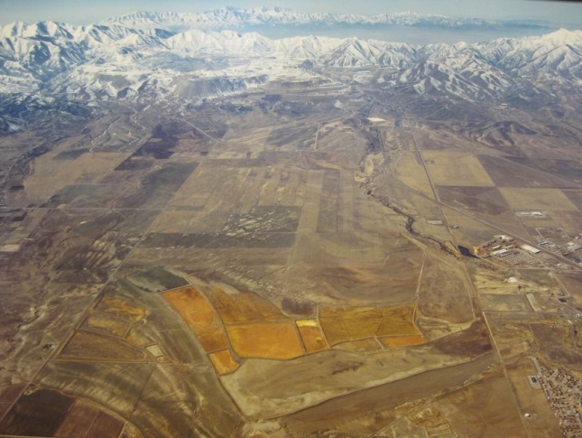
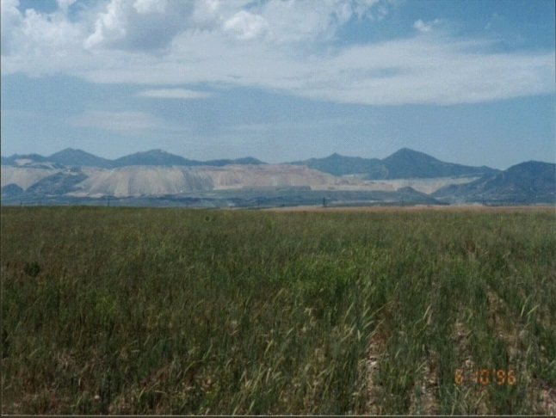
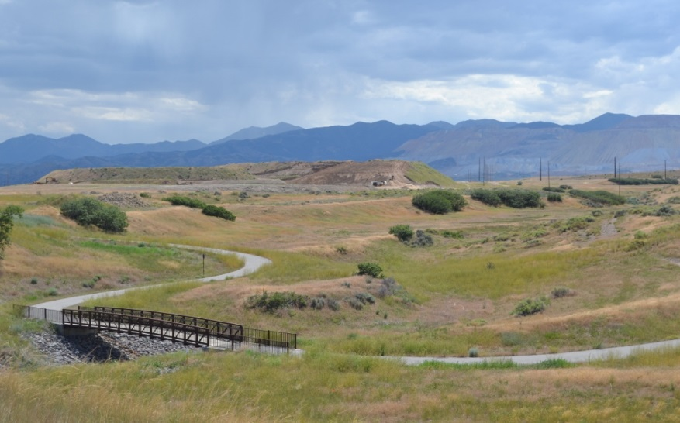
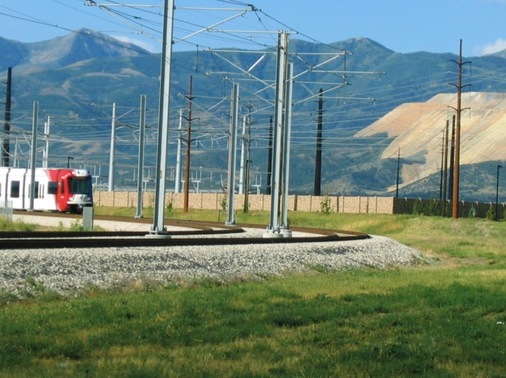
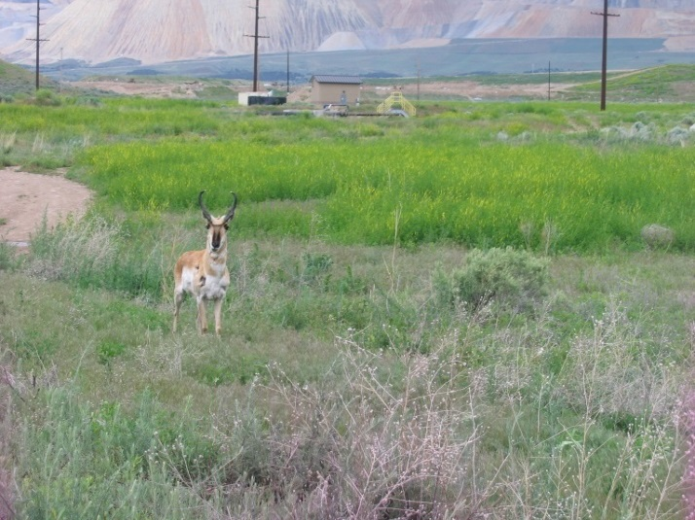
Daybreak Soil Management – Ongoing Efforts
Daybreak, 2006-07
(Source: Kennecott)
South Jordan Evaporation Ponds, 1994-95
(Source: Kennecott)
South Jordan Evaporation Ponds, 1996
(Source: Kennecott)
Bingham Creek (OU1) Channel Trail
(Source: EPA)
Mid Jordan Trax Line
(Source: UDEQ)
Near Bastian Sink
(Source: UDEQ)
Notes:
Daybreak Cleanup & Ongoing Soil Management History At Various Operable Units in Daybreak
OU1: Bingham Creek
As noted previously early response actions took place from 1995 to 1998.
Early response actions (pursuant to risk assessment and characterization efforts) required cleaned up to a commercial land use action level (2,000 mg/Kg).
Bingham Creek Channel forms a portion of the northern boundary of Daybreak from approximately 5000 West to SH-111.
2007-2016 Kennecott included portions of the Bingham Flats Area (now Daybreak Commerce Park), historic rail beds, and Tailwater Ditches under a work plan (accepted by the Agencies, governed by the 2006 O&M work plans) to address soils above the residential land use action levels (As- 100 mg/kg and Pb – 700 mg/kg) for the Daybreak Community and the site wide unrestricted land use action levels (As – 50 mg/kg and Pb – 500 mg/kg).
The further removal response actions were due to ongoing characterization efforts by Kennecott as part of preparing these locations for redevelopment.
The residential land use action levels (selected in 2006 as a result of further risk assessment efforts by Kennecott Land) were selected to avoid the requirement to place an institutional control over these areas.
OU5: Bastian Ditch
Under a Unilateral Administrative Order in 1995 ARCO and Kennecott addressed portions of the Bastian Ditch (an unlined conveyance ditch for water from Bingham Creek) early on as part of the larger cleanups of OU5 and OU1.
The Bastian Ditch crosses portions of what is now designated the West Village of Daybreak.
Subsequent to development activities, characterization efforts in 2006, 2009 and 2015/16 found segments of the Bastian Ditch still in place and delineated another previously unknown group of ditches entitled the Bastian Ditch Drainage Area.
The Bastian Ditch segments and the Bastian Ditch Drainage Area were found to contain soils above the site wide unrestricted land use action levels for arsenic (50 mg/kg) and lead (500 mg/kg) as well as the residential land use action levels established for the Daybreak area (As- 100 mg/kg and Pb- 700 mg/kg).
In 2009 and 2016 further removal action was performed by Kennecott using site specific soil management work plans governed by the 2006 O&M Plan, and accepted by the Agencies.
OU7: South Jordan Evaporation Ponds, Feeder Canals
As noted from 1994 to 1997 Kennecott pursued the original removal action of the South Jordan Evaporation Ponds, which include the removal of lead concentrations above 1,000 mg/Kg and the consolidation and capping of sludges and other solid mine waste (with high soluble sulfate concentrations).
In 2004, (as noted) an O&M plan was put into place to ensure future land use considerations would address the two consolidated repositories of solid mine waste, which happened in 2006.
Daybreak was planned with a lake amenity which in part is used to manage storm water in the Community, and such was planned for where the solid mine waste had previously been capped.
In 2009 under an Agencies accepted work plan Kennecott Land pursued characterization of soils along the Evaporation Pond Canals – Main Feeder and Pond A0 canals and the historic footprint Pond A0.
Soils were found to contain arsenic and lead in excess of the residential land use action levels for the Daybreak Community.
As the area was forecasted to support portions of the East and North Lake Villages, Kennecott assisted Kennecott Land with removing these locations with Agencies oversight under a removal work plan governed by the 2006 O&M work plans.
OU17: Bastian Sink
During the 1994-1997 evaluation of the South Jordan Evaporation Ponds, Kennecott evaluated the Bastian Sink and determined that arsenic and lead concentrations were supportive of the then open space land use.
As noted in 2001 an O&M plan was put in place which required the Bastian Sink area to be re-evaluated and potential receive further response work to address soils with arsenic and lead concentrations above applicable land use action levels.
In 2006, due to the development plan for Daybreak, the Bastian Sink underwent a removal action per the Agencies accepted work plan in the 2006 O&M plan.
Soils were removed to the site wide unrestricted arsenic (50 mg/Kg) and lead (500 mg/Kg) land use action levels.
In 2015 a northern portion of the Bastian Sink was found to have soils with concentrations of arsenic and lead above the site wide unrestricted land use action levels.
Kennecott entered into an Environmental Covenant with UDEQ and EPA to ensure future management of soils if dug into.
Now John Birkinshaw, Rio Tinto Kennecott Copper, Principle Advisor – Land Remediation & Re-Use, will provide information on the redevelopment activities in Daybreak and the effects of this re-use on the surrounding populace.

Slide 11
For More Information, Contact
Douglas Bacon
State of Utah Dept. Environmental Quality
Project Manager - Kennecott
ITRC – State Engagement Coordinator & Utah’s Point of Contact
Phone: 801-536-4282
Email: dbacon@utah.gov

